Slide 1
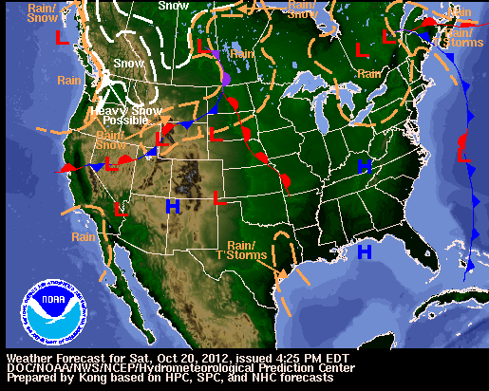
Weather Maps
Notes:
http://www.weather.gov/forecastmaps

Slide 2
Weather Maps
Weather maps are used to show current weather conditions in an effort to predict future weather conditions.
You need to know what each symbol means and how to interpret them to forecast the weather.

Slide 3
Cold Front Symbol
Notes:
http://commons.wikimedia.org/w/index.php?title=File:Cold_front_symbol.svg&page=1

Slide 4
Moves in the Direction of the Triangles
Cold, dense air is moving toward warm, less dense air.
The warm air is pushed up to cool and form clouds as the cooler air replaces it.
The air on the front side of the boundary line is warmer than the air on the back side of the boundary line.
These fronts are usually fast moving and bring stormy weather and heavy precipitation followed by clearing skies and higher pressure.

Slide 5
Warm Front Symbol
Notes:
http://commons.wikimedia.org/w/index.php?title=File:Warm_front_symbol.svg&page=1

Slide 6
Moves in the Direction of the Semi-Circles
Warm air is moving toward cold air.
The warm, less dense air slides over the cold, more dense air.
The air on the front side of the boundary line is cooler than the air on the back side of the boundary line.
These fronts usually move slowly and bring steady rain or snow over many days.

Slide 7
Stationary Front Symbol

Slide 8
Stay in One Area
These fronts occur when neither the cool or warm air masses are strong enough to replace each other.
They tend to stay in an area for a long period of time, often bringing long periods of precipitation and clouds.

Slide 9
High Pressure
Notes:
http://commons.wikimedia.org/w/index.php?title=File:High_pressure_symbol.svg&page=1

Slide 10
Moves toward Low Pressure
Cooler, dense air close to the surface of the Earth.
Surrounded by winds flowing in a clockwise direction in the Northern hemisphere.
Usually brings dry conditions and fair skies.

Slide 11
High Pressure Simulation
Let’s practice.
Remove the lid from the bottle.
Now, replace the lid.
What direction did you turn the lid to tighten it?
Did the lid move up or down?
This is a way to remember high pressure.

Slide 12
Low Pressure
Notes:
http://commons.wikimedia.org/w/index.php?title=File:Low_pressure_symbol.svg&page=1

Slide 13
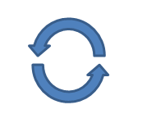
High pressure will move toward low pressure.
Warmer, less dense air above the Earth’s surface
Surrounded by winds moving in a counterclockwise direction in the Northern hemisphere
Associated with the formation of storms

Slide 14
Low Pressure Simulation
Let’s practice.
Remove the lid from the bottle.
What direction did you turn the lid to loosen it?
Did the lid move up or down?
This is a way to remember low pressure.

Slide 15
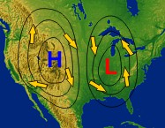
High and Low Pressure Circulation
Notes:
http://www.srh.noaa.gov/srh/jetstream/synoptic/wind.htm

Slide 16
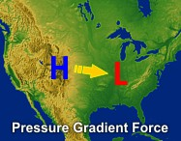
Pressure Force
Notes:
http://www.srh.noaa.gov/srh/jetstream/synoptic/wind.htm

Slide 17
Reflection Questions
Why does the Earth have weather?
How do weather maps show how global patterns of atmospheric movement influence local weather?

